Slide 1



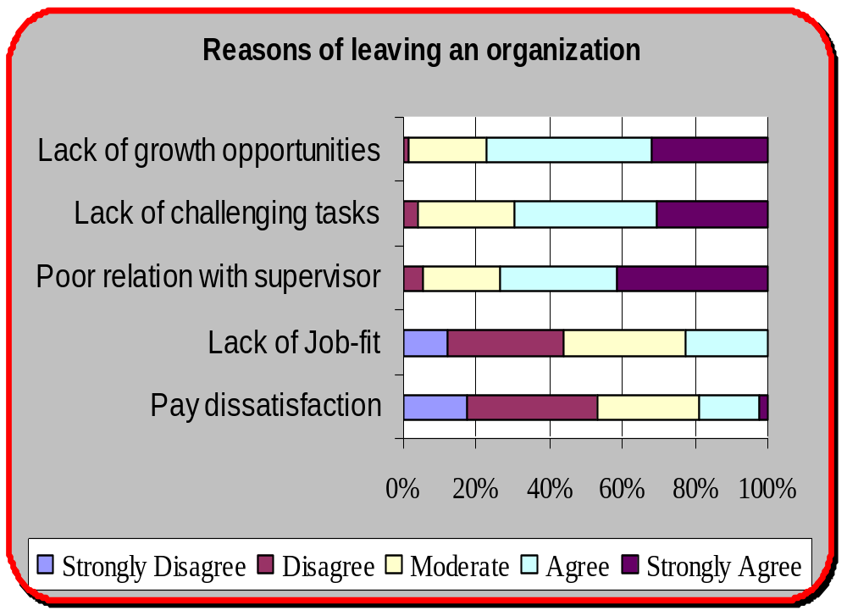

Talent Management “the line of attack” for retaining employees
Give employees what they crave for, create a win-win situation & make a huge difference by doing simple things.
Objective
To determine the reasons of leaving an organization due to poor talent management.
To highlight the general concepts held.
Methodology
Sample size: 75 respondents in Banks & HR Consultancy firms.
Instrument: Questionnaire which consisted of 26 questions.
Key Findings
Conclusion
Respondents prefer jobs that offer growth & are challenging, as they feel that they are adding value to their work & their work is adding value to their abilities.
Individuals claimed that poor relation with supervisor builds a negative work environment & provoke them to leave.
Indication to the general misconception that pay stimulate retention.
Respondents did not consider lack of job-fit as a reason to quit job.
Prepared by: Aumaima Zamin (2464) Supervised by: Mr. Ata-ur-Rehman

